Slide 1

An Introduction to eDNA Surveillance in
Aquatic Systems
C. erde¹, A. Welsh², C. Wilson³, M. Docker⁴, B. Locke⁵
¹University of California – Santa Barbara, ²West Virginia University,
^{3,5}Ontario Ministry of Natural Resources and Forestry,
⁴University of Manitoba
Uses and Limitations of Environmental DNA (eDNA) in Fisheries Management
A science transfer project funded by:

Slide 2
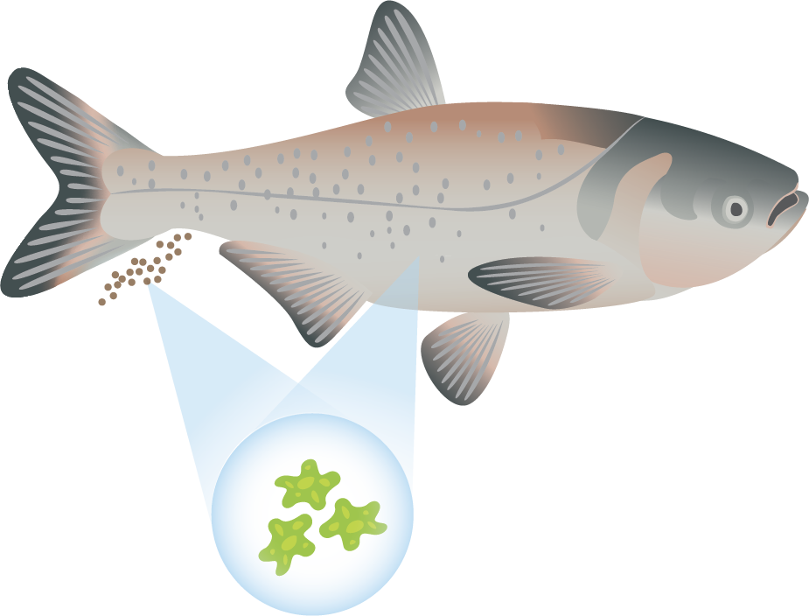
What is environmental DNA (eDNA)?
All organisms shed cells into the environment (e.g. dandruff). In aquatic systems, DNA from species is released into the water in the form of sloughed cells found in urine, feces, and mucus. The DNA can be found in small organelles (parts of cells like the mitochondria) or in larger pieces of tissue made up of many cells.
The idea is that it is easier to catch the DNA than it is to catch the fish!
Notes:
Notes/caption: All cells contain the genetic signature of the organism and individual they come from in the form of the DNA contained within. Environmental DNA, or eDNA for short, is simply bits of organelles that make up cells, cells themselves, or pieces of tissues that are found in the environment. The environment can be in soil, water, or air. For aquatic species, like fish, the idea is that as the fish swims, any number of physiological processes release DNA into the water. For purposes of uncovering the presence of fish, a water sample can be collected that has the DNA from the species found nearby and reveal the presence of a fish or the community of fish in the sample using molecular techniques. This method was developed for Bullfrogs (Ficetola et al. 2008) and first applied to fish by Jerde et al. (2011). Turner et al. (2014) found that the DNA in the water can be found in a range of particle sizes from small organelles of the cell all the way up to pieces of tissue. In general, larger particles, such as tissue fragments have more DNA than a single cell or mitochondria.
Definitions (sourced by Google Dictionary unless otherwise noted):
DNA: deoxyribonucleic acid, a self-replicating material which is present in nearly all living organisms as the main constituent of chromosomes. It is the carrier of genetic information.
Environmental DNA (eDNA): Environmental DNA or eDNA is DNA that is collected from a variety of environmental samples such as soil, seawater, snow or even air rather than directly sampled from an individual organism. As various organisms interact with the environment, DNA is expelled and accumulates in their surroundings. (Wikipedia.org)
Mitochondria: an organelle found in large numbers in most cells, in which the biochemical processes of respiration and energy production occur. It has a double membrane, the inner layer being folded inward to form layers (cristae).
Critical papers (found in folder):
Ficetola, G. F., Miaud, C., Pompanon, F., & Taberlet, P. (2008). Species detection using environmental DNA from water samples. Biology Letters, 4(4), 423-425.
Jerde, C. L., Mahon, A. R., Chadderton, W. L., & Lodge, D. M. (2011). “Sight‐unseen” detection of rare aquatic species using environmental DNA. Conservation Letters, 4(2), 150-157.
Turner, C. R., Barnes, M. A., Xu, C. C., Jones, S. E., Jerde, C. L., & Lodge, D. M. (2014). Particle size distribution and optimal capture of aqueous macrobial eDNA. Methods in Ecology and Evolution, 5(7), 676-684.
Creative Commons Attribution-NonCommercial-ShareAlike 4.0 International Public License
By exercising the Licensed Rights (defined below), You accept and agree to be bound by the terms and conditions of this Creative Commons Attribution-NonCommercial-ShareAlike 4.0 International Public License ("Public License"). To the extent this Public License may be interpreted as a contract, You are granted the Licensed Rights in consideration of Your acceptance of these terms and conditions, and the Licensor grants You such rights in consideration of benefits the Licensor receives from making the Licensed Material available under these terms and conditions.
Section 1 – Definitions.
Adapted Material means material subject to Copyright and Similar Rights that is derived from or based upon the Licensed Material and in which the Licensed Material is translated, altered, arranged, transformed, or otherwise modified in a manner requiring permission under the Copyright and Similar Rights held by the Licensor. For purposes of this Public License, where the Licensed Material is a musical work, performance, or sound recording, Adapted Material is always produced where the Licensed Material is synched in timed relation with a moving image.
Adapter's License means the license You apply to Your Copyright and Similar Rights in Your contributions to Adapted Material in accordance with the terms and conditions of this Public License.
BY-NC-SA Compatible License means a license listed at creativecommons.org/compatiblelicenses, approved by Creative Commons as essentially the equivalent of this Public License.
Copyright and Similar Rights means copyright and/or similar rights closely related to copyright including, without limitation, performance, broadcast, sound recording, and Sui Generis Database Rights, without regard to how the rights are labeled or categorized. For purposes of this Public License, the rights specified in Section 2(b)(1)-(2) are not Copyright and Similar Rights.
Effective Technological Measures means those measures that, in the absence of proper authority, may not be circumvented under laws fulfilling obligations under Article 11 of the WIPO Copyright Treaty adopted on December 20, 1996, and/or similar international agreements.
Exceptions and Limitations means fair use, fair dealing, and/or any other exception or limitation to Copyright and Similar Rights that applies to Your use of the Licensed Material.
License Elements means the license attributes listed in the name of a Creative Commons Public License. The License Elements of this Public License are Attribution, NonCommercial, and ShareAlike.
Licensed Material means the artistic or literary work, database, or other material to which the Licensor applied this Public License.
Licensed Rights means the rights granted to You subject to the terms and conditions of this Public License, which are limited to all Copyright and Similar Rights that apply to Your use of the Licensed Material and that the Licensor has authority to license.
Licensor means the individual(s) or entity(ies) granting rights under this Public License.
NonCommercial means not primarily intended for or directed towards commercial advantage or monetary compensation. For purposes of this Public License, the exchange of the Licensed Material for other material subject to Copyright and Similar Rights by digital file-sharing or similar means is NonCommercial provided there is no payment of monetary compensation in connection with the exchange.
Share means to provide material to the public by any means or process that requires permission under the Licensed Rights, such as reproduction, public display, public performance, distribution, dissemination, communication, or importation, and to make material available to the public including in ways that members of the public may access the material from a place and at a time individually chosen by them.
Sui Generis Database Rights means rights other than copyright resulting from Directive 96/9/EC of the European Parliament and of the Council of 11 March 1996 on the legal protection of databases, as amended and/or succeeded, as well as other essentially equivalent rights anywhere in the world.
You means the individual or entity exercising the Licensed Rights under this Public License. Your has a corresponding meaning.
Section 2 – Scope.
License grant.
Subject to the terms and conditions of this Public License, the Licensor hereby grants You a worldwide, royalty-free, non-sublicensable, non-exclusive, irrevocable license to exercise the Licensed Rights in the Licensed Material to:
reproduce and Share the Licensed Material, in whole or in part, for NonCommercial purposes only; and
produce, reproduce, and Share Adapted Material for NonCommercial purposes only.
Exceptions and Limitations. For the avoidance of doubt, where Exceptions and Limitations apply to Your use, this Public License does not apply, and You do not need to comply with its terms and conditions.
Term. The term of this Public License is specified in Section 6(a).
Media and formats; technical modifications allowed. The Licensor authorizes You to exercise the Licensed Rights in all media and formats whether now known or hereafter created, and to make technical modifications necessary to do so. The Licensor waives and/or agrees not to assert any right or authority to forbid You from making technical modifications necessary to exercise the Licensed Rights, including technical modifications necessary to circumvent Effective Technological Measures. For purposes of this Public License, simply making modifications authorized by this Section 2(a)(4) never produces Adapted Material.
Downstream recipients.Offer from the Licensor – Licensed Material. Every recipient of the Licensed Material automatically receives an offer from the Licensor to exercise the Licensed Rights under the terms and conditions of this Public License.
Additional offer from the Licensor – Adapted Material. Every recipient of Adapted Material from You automatically receives an offer from the Licensor to exercise the Licensed Rights in the Adapted Material under the conditions of the Adapter’s License You apply.
No downstream restrictions. You may not offer or impose any additional or different terms or conditions on, or apply any Effective Technological Measures to, the Licensed Material if doing so restricts exercise of the Licensed Rights by any recipient of the Licensed Material.
No endorsement. Nothing in this Public License constitutes or may be construed as permission to assert or imply that You are, or that Your use of the Licensed Material is, connected with, or sponsored, endorsed, or granted official status by, the Licensor or others designated to receive attribution as provided in Section 3(a)(1)(A)(i).
Other rights.
Moral rights, such as the right of integrity, are not licensed under this Public License, nor are publicity, privacy, and/or other similar personality rights; however, to the extent possible, the Licensor waives and/or agrees not to assert any such rights held by the Licensor to the limited extent necessary to allow You to exercise the Licensed Rights, but not otherwise.
Patent and trademark rights are not licensed under this Public License.
To the extent possible, the Licensor waives any right to collect royalties from You for the exercise of the Licensed Rights, whether directly or through a collecting society under any voluntary or waivable statutory or compulsory licensing scheme. In all other cases the Licensor expressly reserves any right to collect such royalties, including when the Licensed Material is used other than for NonCommercial purposes.
Section 3 – License Conditions.
Your exercise of the Licensed Rights is expressly made subject to the following conditions.
Attribution.
If You Share the Licensed Material (including in modified form), You must:
retain the following if it is supplied by the Licensor with the Licensed Material:
identification of the creator(s) of the Licensed Material and any others designated to receive attribution, in any reasonable manner requested by the Licensor (including by pseudonym if designated);
a copyright notice;
a notice that refers to this Public License;
a notice that refers to the disclaimer of warranties;
a URI or hyperlink to the Licensed Material to the extent reasonably practicable;
indicate if You modified the Licensed Material and retain an indication of any previous modifications; and
indicate the Licensed Material is licensed under this Public License, and include the text of, or the URI or hyperlink to, this Public License.
You may satisfy the conditions in Section 3(a)(1) in any reasonable manner based on the medium, means, and context in which You Share the Licensed Material. For example, it may be reasonable to satisfy the conditions by providing a URI or hyperlink to a resource that includes the required information.
If requested by the Licensor, You must remove any of the information required by Section 3(a)(1)(A) to the extent reasonably practicable.
ShareAlike.In addition to the conditions in Section 3(a), if You Share Adapted Material You produce, the following conditions also apply.
The Adapter’s License You apply must be a Creative Commons license with the same License Elements, this version or later, or a BY-NC-SA Compatible License.
You must include the text of, or the URI or hyperlink to, the Adapter's License You apply. You may satisfy this condition in any reasonable manner based on the medium, means, and context in which You Share Adapted Material.
You may not offer or impose any additional or different terms or conditions on, or apply any Effective Technological Measures to, Adapted Material that restrict exercise of the rights granted under the Adapter's License You apply.
Section 4 – Sui Generis Database Rights.
Where the Licensed Rights include Sui Generis Database Rights that apply to Your use of the Licensed Material:
for the avoidance of doubt, Section 2(a)(1) grants You the right to extract, reuse, reproduce, and Share all or a substantial portion of the contents of the database for NonCommercial purposes only;
if You include all or a substantial portion of the database contents in a database in which You have Sui Generis Database Rights, then the database in which You have Sui Generis Database Rights (but not its individual contents) is Adapted Material, including for purposes of Section 3(b); and
You must comply with the conditions in Section 3(a) if You Share all or a substantial portion of the contents of the database.
For the avoidance of doubt, this Section 4 supplements and does not replace Your obligations under this Public License where the Licensed Rights include other Copyright and Similar Rights.Section 5 – Disclaimer of Warranties and Limitation of Liability.
Unless otherwise separately undertaken by the Licensor, to the extent possible, the Licensor offers the Licensed Material as-is and as-available, and makes no representations or warranties of any kind concerning the Licensed Material, whether express, implied, statutory, or other. This includes, without limitation, warranties of title, merchantability, fitness for a particular purpose, non-infringement, absence of latent or other defects, accuracy, or the presence or absence of errors, whether or not known or discoverable. Where disclaimers of warranties are not allowed in full or in part, this disclaimer may not apply to You.
To the extent possible, in no event will the Licensor be liable to You on any legal theory (including, without limitation, negligence) or otherwise for any direct, special, indirect, incidental, consequential, punitive, exemplary, or other losses, costs, expenses, or damages arising out of this Public License or use of the Licensed Material, even if the Licensor has been advised of the possibility of such losses, costs, expenses, or damages. Where a limitation of liability is not allowed in full or in part, this limitation may not apply to You.
The disclaimer of warranties and limitation of liability provided above shall be interpreted in a manner that, to the extent possible, most closely approximates an absolute disclaimer and waiver of all liability.
Section 6 – Term and Termination.
This Public License applies for the term of the Copyright and Similar Rights licensed here. However, if You fail to comply with this Public License, then Your rights under this Public License terminate automatically.
Where Your right to use the Licensed Material has terminated under Section 6(a), it reinstates:
automatically as of the date the violation is cured, provided it is cured within 30 days of Your discovery of the violation; or
upon express reinstatement by the Licensor.
For the avoidance of doubt, this Section 6(b) does not affect any right the Licensor may have to seek remedies for Your violations of this Public License.
For the avoidance of doubt, the Licensor may also offer the Licensed Material under separate terms or conditions or stop distributing the Licensed Material at any time; however, doing so will not terminate this Public License.
Sections 1, 5, 6, 7, and 8 survive termination of this Public License.
Section 7 – Other Terms and Conditions.
The Licensor shall not be bound by any additional or different terms or conditions communicated by You unless expressly agreed.
Any arrangements, understandings, or agreements regarding the Licensed Material not stated herein are separate from and independent of the terms and conditions of this Public License.
Section 8 – Interpretation.
For the avoidance of doubt, this Public License does not, and shall not be interpreted to, reduce, limit, restrict, or impose conditions on any use of the Licensed Material that could lawfully be made without permission under this Public License.
To the extent possible, if any provision of this Public License is deemed unenforceable, it shall be automatically reformed to the minimum extent necessary to make it enforceable. If the provision cannot be reformed, it shall be severed from this Public License without affecting the enforceability of the remaining terms and conditions.
No term or condition of this Public License will be waived and no failure to comply consented to unless expressly agreed to by the Licensor.
Nothing in this Public License constitutes or may be interpreted as a limitation upon, or waiver of, any privileges and immunities that apply to the Licensor or You, including from the legal processes of any jurisdiction or authority.
Creative Commons is not a party to its public licenses. Notwithstanding, Creative Commons may elect to apply one of its public licenses to material it publishes and in those instances will be considered the “Licensor.” The text of the Creative Commons public licenses is dedicated to the public domain under the CC0 Public Domain Dedication. Except for the limited purpose of indicating that material is shared under a Creative Commons public license or as otherwise permitted by the Creative Commons policies published at creativecommons.org/policies, Creative Commons does not authorize the use of the trademark “Creative Commons” or any other trademark or logo of Creative Commons without its prior written consent including, without limitation, in connection with any unauthorized modifications to any of its public licenses or any other arrangements, understandings, or agreements concerning use of licensed material. For the avoidance of doubt, this paragraph does not form part of the public licenses.

Slide 3
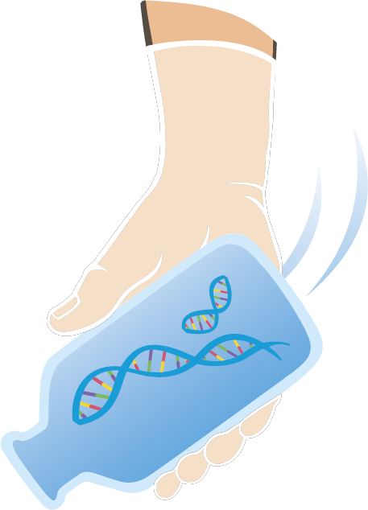

Why do we use eDNA?
Not all species are easy to catch using traditional methods (hook and line, nets, electrofishing, trawls)
Even when species are easily caught, if the species is rare, then they are often missed
In large systems, such as the Laurentian Great Lakes, it is impossible to sample everywhere using traditional methods
eDNA can be applied for difficult to capture species, at low abundance, in places where traditional methods are difficult to deploy, and across vast landscapes
Notes:
Notes/caption: For many environmental management and science applications, knowing where and when a species is present is critical. Applications include early detection of invasive species for effective control and eradication, and protecting critical habitats of rare, threatened and endangered species. Many species are inherently difficult to catch or detect, and when rare, it becomes increasingly likely that no matter the amount of effort applied, the species will not be detected. Environmental DNA has been shown to be more sensitive to detecting a wide variety of aquatic species and relatively easy to apply across large water bodies (McKelvey et al. 2016). The overall approach to eDNA surveillance overcomes many of the limitations posed by traditional fisheries tools, such as hook and line, nets, electrofishing, and trawls (Rees et al. 2014). In the Laurentian Great Lakes, the effort for early detection if Eurasian ruffe has been hampered by the only effective gear type able to catch the species (trawling) being very difficult and costly to apply. In contrast, eDNA samples were collected in areas known to have high, moderate and low densities and showed a similar pattern of presence. Additionally, eDNA was deployed across a large geographic area and in locations where trawling was difficult or impossible (Tucker et al. 2016).
Definitions (sourced by Google Dictionary unless otherwise noted):
Critical papers (found in folder):
McKelvey, K. S., Young, M. K., Knotek, W. L., Carim, K. J., Wilcox, T. M., Padgett‐Stewart, T. M., & Schwartz, M. K. (2016). Sampling large geographic areas for rare species using environmental DNA: a study of bull trout Salvelinus confluentus occupancy in western Montana. Journal of Fish Biology, 88(3), 1215-1222.
Rees, H. C., Maddison, B. C., Middleditch, D. J., Patmore, J. R., & Gough, K. C. (2014). The detection of aquatic animal species using environmental DNA–a review of eDNA as a survey tool in ecology. Journal of Applied Ecology, 51(5), 1450-1459.
Tucker, A. J., Chadderton, W. L., Jerde, C. L., Renshaw, M. A., Uy, K., Gantz, C., ... & Sieracki, J. L. (2016). A sensitive environmental DNA (eDNA) assay leads to new insights on Ruffe (Gymnocephalus cernua) spread in North America. Biological Invasions, 18(11), 3205-3222.

Slide 4
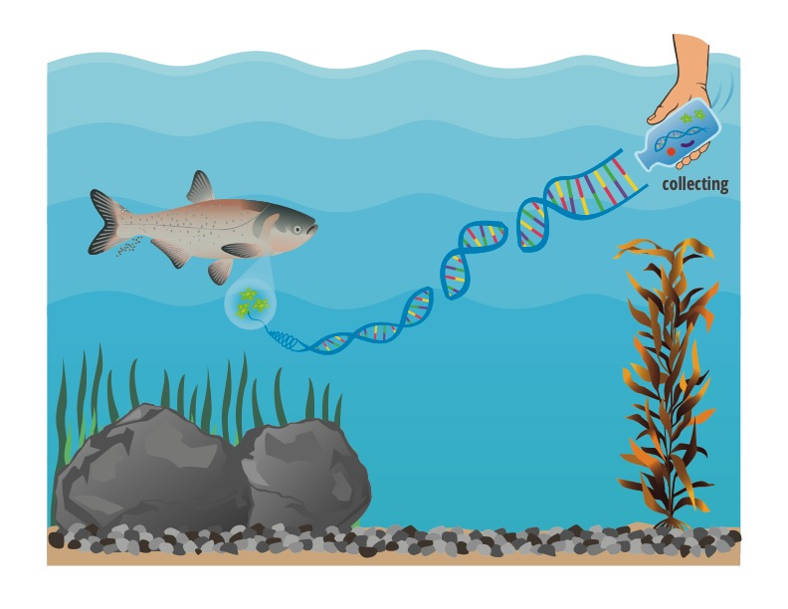
How does eDNA surveillance work (in general)?
A water sample is collected
The DNA is isolated on a filter
The DNA is extracted from the filter
The DNA is screened for presence of the organism’s telltale signature
There are two general ways the DNA can be screened
Notes:
Notes/caption: The general approach described here has been widely applied in the Great Lakes, but many modifications exist (Rees et al. 2014). For example, the very first eDNA paper used a precipitation of the DNA from a small amount of water (15ml) instead of filtration (Ficetola et al. 2008). As the eDNA approach evolves, it should be expected that this approach will change and be modified to increase detection sensitivity (Goldberg et al. 2016). In general filtration allows for filtering more water and capturing more DNA.
Definitions (sourced by Google Dictionary unless otherwise noted):
Critical papers (found in folder):
Ficetola, G. F., Miaud, C., Pompanon, F., & Taberlet, P. (2008). Species detection using environmental DNA from water samples. Biology Letters, 4(4), 423-425.
Goldberg, C. S., Turner, C. R., Deiner, K., Klymus, K. E., Thomsen, P. F., Murphy, M. A., ... & Laramie, M. B. (2016). Critical considerations for the application of environmental DNA methods to detect aquatic species. Methods in Ecology and Evolution, 7(11), 1299-1307.
Rees, H. C., Maddison, B. C., Middleditch, D. J., Patmore, J. R., & Gough, K. C. (2014). The detection of aquatic animal species using environmental DNA–a review of eDNA as a survey tool in ecology. Journal of Applied Ecology, 51(5), 1450-1459.

Slide 5
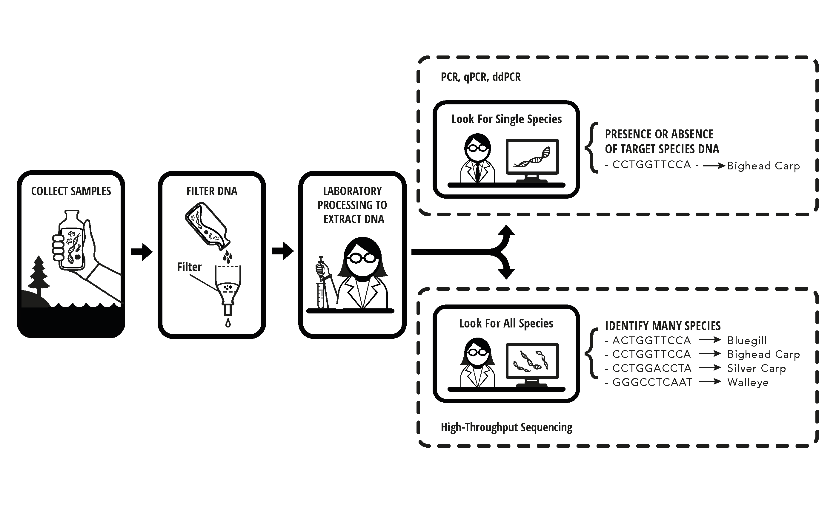
Once the sample is collected, filtered, and
the DNA is extracted, the DNA can be screened
using two different approaches
Active surveillance: using technology and molecular techniques to evaluate if a species is present (e.g. PCR, qPCR, ddPCR)
Passive surveillance: using technology and molecular techniques to evaluate the presence and identity of many species (High-Throughput Sequencing (HTS))
Notes:
Notes/caption: The process of collecting a water sample, filtration, and extraction are the same irrespective of the molecular technique used to screen for species presence (Goldberg et al. 2016). Simmons et al. (2016) differentiated two processes to screen for species presence. One approach to invasive species surveillance would be to build species-specific molecular markers for each of these invasive fish and actively screen each sample (Ficetola et al. 2008) or to use a general fish marker and then use High Throughput Sequencing (HTS) to passively screen the sample for all fish DNA and determine the identity of all fish in the system (Thomsen et al. 2012). Common approaches of active surveillance are PCR (Polymerase Chain Reaction), qPCR (quantitative PCR), and ddPCR (digital droplet PCR) - each providing differing levels of sensitivity and quantification of the amount of DNA found in the sample (Nathan et al. 2014). In contrast, the passive approach uses a region of DNA found in all fish (for example) that within that region, there are differences in the DNA that allow for differentiation of species when the sequences are read using high throughput sequencing. At this time, active surveillance is considerably cheaper than passive surveillance. However, HTS allows for the simultaneous detection of many species, some of which may be unexpected (Simmons et al. 2016) allowing for improved resource management of fisheries.
Definitions (sourced by Google Dictionary unless otherwise noted):
PCR: Polymerase chain reaction, or PCR, is a laboratory technique used to make multiple copies of a segment of DNA. PCR is very precise and can be used to amplify, or copy, a specific DNA target from a mixture of DNA molecules.
qPCR: The method of choice for nucleic acid (DNA, RNA) quantification in all areas of molecular biology is real-time PCR or quantitative PCR (qPCR). The method´s name derives from the fact that the amplification of DNA by polymerase chain reaction (PCR) is monitored in real time.
ddPCR: Droplet Digital PCR (ddPCR) is a method for performing digital PCR that is based on water-oil emulsion droplet technology. A sample is fractionated into 20,000 droplets, and PCR amplification of the template molecules occurs in each individual droplet. ddPCR technology uses reagents and workflows similar to those used for most standard TaqMan probe-based assays. The massive sample partitioning is a key aspect of the ddPCR technique. From www.bio-rad.com
High throughput sequencing: “… [a] method used to determine a portion of the nucleotide sequence of an individual’s genome. This technique utilizes DNA sequencing technologies that are capable of processing multiple DNA sequences in parallel.” From the National Cancer Institute Dictionary of Genetic Terms.
Species specific marker: a segment of DNA unique to a single species (Simmons et al. 2016)
General fish marker: s segment of DNA that is common across all fish, but within the sequence of DNA, there are differences in nucleotides that can be traced to unique fish species (Simmons et al. 2016).
Critical papers (found in folder):
Ficetola, G. F., Miaud, C., Pompanon, F., & Taberlet, P. (2008). Species detection using environmental DNA from water samples. Biology Letters, 4(4), 423-425.
Goldberg, C. S., Turner, C. R., Deiner, K., Klymus, K. E., Thomsen, P. F., Murphy, M. A., ... & Laramie, M. B. (2016). Critical considerations for the application of environmental DNA methods to detect aquatic species. Methods in Ecology and Evolution, 7(11), 1299-1307.
Nathan, L. M., Simmons, M., Wegleitner, B. J., Jerde, C. L., & Mahon, A. R. (2014). Quantifying environmental DNA signals for aquatic invasive species across multiple detection platforms. Environmental science & technology, 48(21), 12800-12806.
Simmons, M., Tucker, A., Chadderton, W. L., Jerde, C. L., & Mahon, A. R. (2016). Active and passive environmental DNA surveillance of aquatic invasive species. Canadian Journal of Fisheries and Aquatic Sciences, 73(1), 76-83.
Thomsen, P. F., Kielgast, J., Iversen, L. L., Møller, P. R., Rasmussen, M., & Willerslev, E. (2012). Detection of a diverse marine fish fauna using environmental DNA from seawater samples. PLoS one, 7(8), e41732.

Slide 6
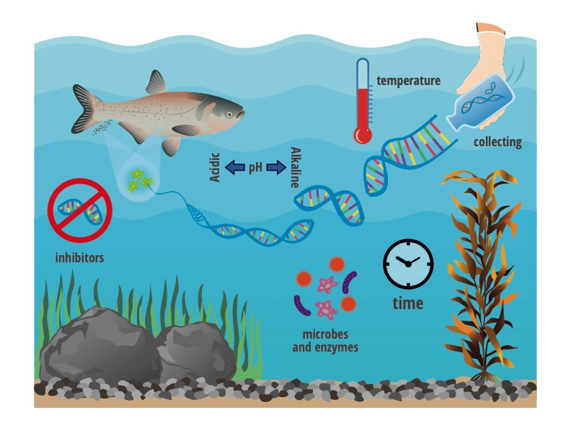
What can prevent eDNA from being detected when a fish is present?
DNA degrades at different rates:
Temperature
pH
Inhibitors (e.g. humic acid)
Microbes and enzymes
Notes:
Notes/caption: Once DNA is released into the environment it can persist or degrade depending on the environmental conditions it is released into (Barnes et al. 2014). High temperatures can degrade DNA where cold temperatures will slow the degradation process (Strickler et al. 2014). Extremes in pH (Acidic or Alkaline) will degrade DNA quickly (Strickler et al. 2014). Microbes and enzymes may also degrade DNA, but it is also highly correlated with temperature (Tsuji et al. 2017). Inhibitors do not necessary degrade the DNA, but humic acids (Tebbe and Vehjen 1993) and presence of clay particulate can bind DNA and prevent if from being extracted out of the water sample during processing with out additional steps. Some have suggested that UV light entering the water column will degrade DNA (Strickler et al. 2014), but research has not born that out (Andruszkiewicz et al. 2017).
Definitions (sourced by Google Dictionary unless otherwise noted):
Critical papers (found in folder):
Andruszkiewicz, E. A., Sassoubre, L. M., & Boehm, A. B. (2017). Persistence of marine fish environmental DNA and the influence of sunlight. PloS one, 12(9), e0185043.
Barnes, M. A., Turner, C. R., Jerde, C. L., Renshaw, M. A., Chadderton, W. L., & Lodge, D. M. (2014). Environmental conditions influence eDNA persistence in aquatic systems. Environ. Sci. Technol, 48(3), 1819-1827.
Strickler, K. M., Fremier, A. K., & Goldberg, C. S. (2015). Quantifying effects of UV-B, temperature, and pH on eDNA degradation in aquatic microcosms. Biological Conservation, 183, 85-92.
Tebbe, C. C., & Vahjen, W. (1993). Interference of humic acids and DNA extracted directly from soil in detection and transformation of recombinant DNA from bacteria and a yeast. Appl. Environ. Microbiol., 59(8), 2657-2665.
Tsuji, S., Ushio, M., Sakurai, S., Minamoto, T., & Yamanaka, H. (2017). Water temperature-dependent degradation of environmental DNA and its relation to bacterial abundance. PLoS One, 12(4), e0176608.

Slide 7
How can eDNA be detected WITHOUT a live fish being present?
Contamination – DNA of the species unintentionally getting into supplies, chemicals, instruments used in the eDNA method
Misidentification – Morphometric identification of fish is different from genetic identification
Hybridization – eDNA uses mitochondrial DNA which is materially inherited; if parents are two species, progeny may look like one species but have the genetic signature of the other
Dead fish – DNA persists in the environment beyond the life span of the organism
Fish swim – The fish’s DNA is in the environment but the fish has left the area
Vectors of DNA transport – some other mechanism, other than a live fish, has allowed DNA to be transported into the system. Ex: water flow, fish eating birds defecating in the water
Best practices, updated species lists, basic biology research, and testing of alternative explanations can address these issues
Notes:
Notes/caption:
Contamination, while uncommon, can occur when lab supplies, chemicals, instruments used in eDNA surveillance get exposed to DNA from the species being investigated. Best practices in keeping labs clean and regular checking of the supplies chemical and instruments can quantify contamination. The use of negative controls during sample collection and laboratory procedures help detect the presence of contamination. These quality assurances and controls are critical for reducing false positives and providing reliable eDNA results (Darling and Mahon 2011, Goldberg et al. 2016).
Misidentification occurs when the long term record of species presence from direct capture has a misidentified species. Misidentification of species is a common problem to fisheries managers when species are characteristically very similar in distinguishing features (i.e. bluegill and green sunfish, various subspecies of cutthroat trout) (Miller et al. 2011). Arguably this is not a false positive tied to eDNA, but rather a problem with using traditional methods and only visual fish identification methods to infer species presence.
Hybridization is when individuals of two different species mate. eDNA currently uses mitochondrial DNA, which is inherited maternally. If the mother of a fish was one species and the father was a different species, they will have the eDNA signature of the mother. The well known eDNA application for bighead and silver carp has this issue because the two species are known to hybridize (Lamer et al. 2010).
Dead fish release tissue as their bodies decompose and thus release eDNA that is detectable. The use of RNA is being considered as an approach to overcome the species detections from dead individuals. When an individual dies, RNA production nearly ceases and should not be found readily in the environment (Pochon et al. 2017).
Fish swim. The fact that fish are mobile species means that during physical capture efforts, the fish may have been absent while during the eDNA effort, the fish was present. This was a long standing issue with initial application of eDNA for Asian carp, when collected samples that tested positive for species present were 30-60 days old and follow up surveys using traditional capture methods yielded no captures (Jerde et al. 2011, 2013). The improvement in eDNA methodology and the ongoing development of portable eDNA screening methods will overcome this issue in the future (Egan et al. 2015).
Vectors of transport other than live fish may give rise to eDNA being in the water. For example, in streams and rivers, the upstream water may have the target organism present, which will lead to downstream detection because the eDNA flows in the water (Shogren et al. 2017). Others have implicated fish eating birds that defecate trace amounts of fish DNA as an alternative explanation to eDNA detection (Guilfoyle and Schultz 2017).
Definitions (sourced by Google Dictionary unless otherwise noted):
Critical papers (found in folder):
Darling, J. A., & Mahon, A. R. (2011). From molecules to management: adopting DNA-based methods for monitoring biological invasions in aquatic environments. Environmental research, 111(7), 978-988.
Egan, S. P., Grey, E., Olds, B., Feder, J. L., Ruggiero, S. T., Tanner, C. E., & Lodge, D. M. (2015). Rapid molecular detection of invasive species in ballast and harbor water by integrating environmental DNA and light transmission spectroscopy. Environmental science & technology, 49(7), 4113-4121.
Goldberg, C. S., Turner, C. R., Deiner, K., Klymus, K. E., Thomsen, P. F., Murphy, M. A., ... & Laramie, M. B. (2016). Critical considerations for the application of environmental DNA methods to detect aquatic species. Methods in Ecology and Evolution, 7(11), 1299-1307.
Guilfoyle, M. P., & Schultz, M. T. (2017). The contribution of double-crested cormorants (Phalacrocorax auritus) to silver carp (Hypophthalmichthys molitrix) DNA loads in the Chicago Area Waterway System. Journal of Great Lakes research, 43(6), 1181-1185.
Lamer, J. T., Dolan, C. R., Petersen, J. L., Chick, J. H., & Epifanio, J. M. (2010). Introgressive hybridization between bighead carp and silver carp in the Mississippi and Illinois Rivers. North American Journal of Fisheries Management, 30(6), 1452-1461.
Miller, D. A., Nichols, J. D., McClintock, B. T., Grant, E. H. C., Bailey, L. L., & Weir, L. A. (2011). Improving occupancy estimation when two types of observational error occur: non‐detection and species misidentification. Ecology, 92(7), 1422-1428.
Pochon, X., Zaiko, A., Fletcher, L. M., Laroche, O., & Wood, S. A. (2017). Wanted dead or alive? Using metabarcoding of environmental DNA and RNA to distinguish living assemblages for biosecurity applications. PloS one, 12(11), e0187636.
Shogren, A. J., Tank, J. L., Andruszkiewicz, E., Olds, B., Mahon, A. R., Jerde, C. L., & Bolster, D. (2017). Controls on eDNA movement in streams: Transport, retention, and resuspension. Scientific Reports, 7(1), 5065.

